Slide 1

WESPE: Weakly Supervised Photo Enhancer for Digital Cameras
Authors: Andrey Ignatov, Nikolay Kobyshev, Kenneth Vanhoey, Radu Timofte, Luc Van Gool
CVPR 2018
Presented by: Felix Singerman - 7970742 , Rishabh Kukreja - 300086824
December 4, 2018
Faculté de genie | Faculty of Engineering
uOttawa.ca

Slide 2
Agenda
Introduction
Contributions
Proposed method
Content Consistency Loss
Adversarial Color Loss
Adversarial Texture Loss
TV Loss
Sum of Losses
Network Architecture
Experiments
Summary
Q&A

Slide 3
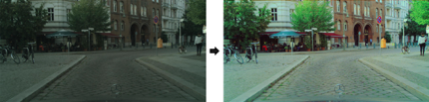
Introduction
● Low-end and compact mobile cameras demonstrate limited photo quality mainly due to space, hardware and budget constraints.
● In this work, we propose a deep learning solution that translates photos taken by cameras with limited capabilities into DSLR-quality photos automatically.
● Yet, one of the major bottlenecks of these solutions is the need for strong supervision using matched before/after training pairs of images. This requirement is often the source of a strong limitation of color/texture transfer and photo enhancement methods.
● We tackle this problem by introducing a weakly supervised photo enhancer (WESPE) - a novel image-to-image GAN-based architecture.
● The proposed model is trained by weakly supervised learning: unlike previous works, there is no need for strong supervision in the form of a large annotated dataset of aligned original/enhanced photo pairs

Slide 4
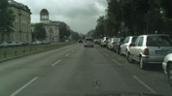
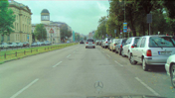
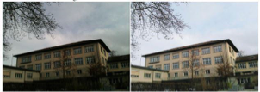
● The sole requirement is two distinct datasets:
one from the source camera,
one composed of arbitrary high-quality
● Hence, our solution is repeatable for any camera: collecting the data and training can be achieved in a couple of hours.
● The experiments demonstrate that WESPE produces comparable or improved qualitative results with state-of-the-art strongly supervised methods

Slide 5
Contributions
Enhanced images improve the non enhanced ones in several aspects, including colorization, resolution and sharpness. Our contributions include:
WESPE, a generic method for learning a model that enhances source images into DSLR-quality ones,
A transitive CNN-GAN architecture, made suitable for the task of image enhancement and image domain transfer by combining state of the art losses with a content loss expressed on the input image,
Large-scale experiments on several publicly available datasets with a variety of camera types, including subjective rating and comparison to the state of the art enhancement methods,
A Flickr Faves Score (FFS) dataset consisting of 16K HD resolution Flickr photos with an associated number of likes and views that we use for training a separate scoring CNN to independently assess image quality of the photos throughout our experiments

Slide 6
Proposed Method
Goal - To learn a mapping from
Dom(X ) Dom(Y)
Model consist of 2 mappings:
1.Generative mapping
2.Inverse Generative mapping
To measure content consistency, we require content loss b/w input x and G(x) which is defined b/w original image and reconstructed image ẋ
(Low Quality)
(High Quality)
Generative Mapping + Inverse Generative Mapping
x = Original Image
x = Reconstructed Image F(G(x))

Slide 7
Objective
1.Content Consistency Loss
● To ensure G(x) preserve the x’s content
2.Two Adversarial Losses
● Color Loss
● Texture Loss
3.Total Variation Loss
● For smoother results

Slide 8
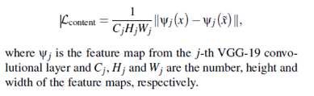
Content Consistency Loss
●We define the content consistency loss in the input image domain X i.e on x and x
x = Original Image
●Our network is trained for both generative mapping G(x) as well as for inverse generative mapping F(X) and is aimed towards strong content similarity b/w original and enhanced images
●Pixel losses are restrictive, so we choose perceptual Content loss based on Relu activation

Slide 9
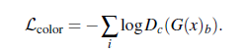
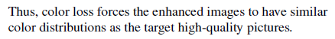
Adversarial Color Loss
● To measure color quality Dc (adversarial discriminator) is trained to differentiate b/w blurred versions of enhanced images and high quality images
● Main idea is to make the discriminator learn the differences in
1. Brightness
2. Contrast
3. Major color differences b/w low and high quality images
● We avoid texture and content comparison by defining a constant sigma very small which is used in Gaussian blur

Slide 10
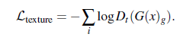
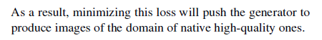
Adversarial Texture Loss
● Similarly to color, image texture quality is also assessed by an adversarial discriminator Dt
● It is applied to grayscale images and is trained to predict whether a given image was artificially enhanced ( ˜ yg) or is a “true” native high-quality image (yg).
● The network is trained to minimize the cross entropy loss function, the loss is defined as:

Slide 11
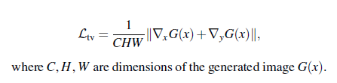
Total Variation (TV) Loss
● To impose spatial smoothness of the generated images we also add a total variation loss defined as follows:

Slide 12
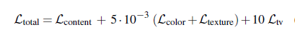
Sum of Losses
● The final WESPE loss is composed of a linear combination of the four mentioned losses:
1. Content Loss
2. Adversarial Color Loss
3. Adversarial Texture Loss
4. TV Loss

Slide 13
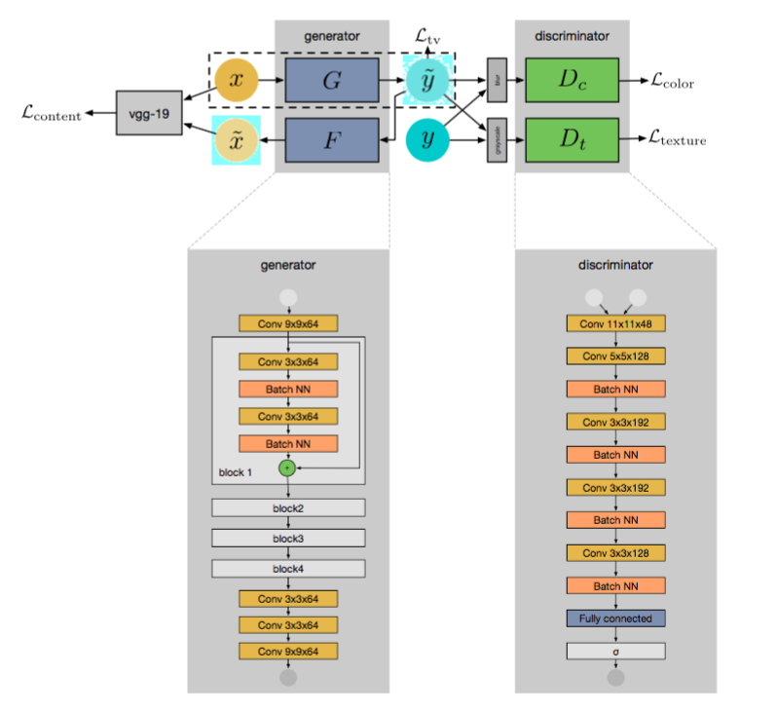
Network Architecture & Training Details
Notes:
Both generative and inverse generative networks G and F are fully-convolutional residual CNNs with four residual blocks, their architecture was adapted from [13].
The discriminator CNNs consist of five convolutional and one fully-connected layer with 1024 neurons, followed by the last layer with a sigmoid activation function on top of it. The first, second and fifth convolutional layers are strided with a step size of 4, 2 and 2, respectively.
network was trained on an NVIDIA Titan X GPU for 20K iterations using a batch size of 30 and the size of the input patches was 100×100 pixels. The parameters of the networks were optimized using the Adam algorithm. The experimental setup was identical in all experiments.

Slide 14
Experiments
Series of experiments covering several cameras and datasets
Compared against: Commercial software baseline, Ignatov et al.,
Full reference evaluation using DPED dataset used for supervised learning by Ignatov et al.
In the wild, as no ground truth needed
Subjective study using human raters
Flickr faves score emulator

Slide 15
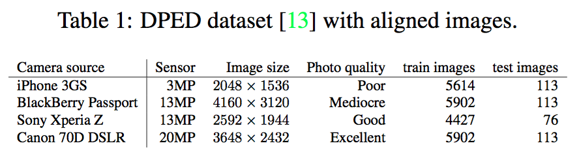
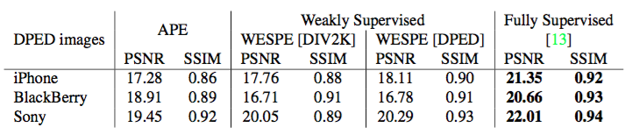
Full-reference evaluation
Performed on the DPED dataset
Point Signal-to-Noise Ratio (PSNR)
Similarity index measure (SSIM)
Notes:
In this section, we perform our experiments on the the DPED dataset (see Table 1) that was initially proposed for learning a photo enhancer with full supervision.
Thanks to this pixel-aligned ground truth before/after data, we can exploit full-reference image quality metrics to compare the enhanced test images with the ground truth high-quality ones.
The former measures the amount of signal lost w.r.t. a reference signal (e.g., an image), the latter compares two images’ similarity in terms of visually structured elements and is known for its improved correlation with human perception.
Signal-to-noise: compares the level of a desired signal to the level of background noise. SNR is defined as the ratio of signal power to the noise power, often expressed in decibels
signal-to-noise ratio of 100 dB, it means that the level of the audio signal is 100 dB higher than the level of the noise
structural similarity (SSIM) index is a method for predicting the perceived quality of digital television and cinematic pictures, as well as other kinds of digital images and videos. SSIM is used for measuring the similarity between two images. The SSIM index is a full reference metric; in other words, the measurement or prediction of image quality is based on an initial uncompressed or distortion-free image as reference.
Our WESPE method trained with the DPED DSLR target performs better than the baseline method (APE). Considering the better SSIM metric only, it is even almost as good as the network in [13] that uses a fully supervised approach and requires pixel-aligned ground truth images.
WESPE trained on DIV2K images as target (WESPE [DIV2K]) and tested w.r.t. DPED images degrades PSNR and SSIM scores compared to WESPE [DPED], but still remains above APE. This is unsurprising as we are measuring proximity to known ground truth images laying in the domain of DPED DSLR photos (and not DIV2K): being close to it does not necessarily imply looking good.

Slide 16
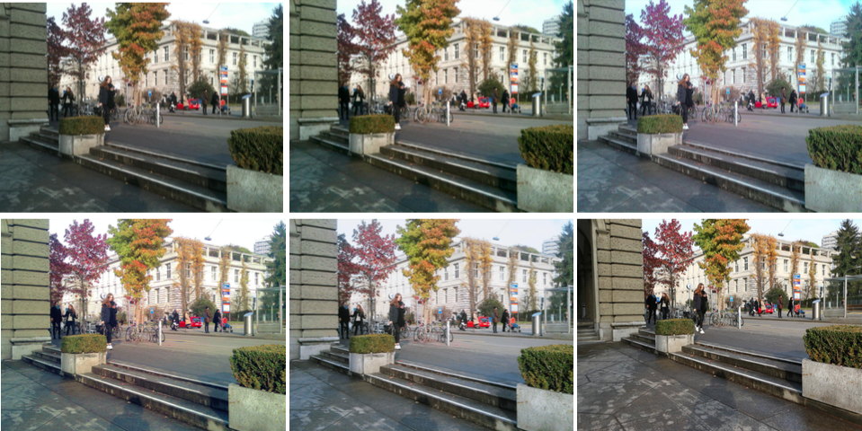
iPhone
Apple Photo Enhancer
WESPE trained on DPED
WESPE trained on DIV2K
Strong Supervised
DSLR
Notes:
Figure 3: From left to right, top to bottom: original iPhone photo and the same image after applying, resp.: Apple Photo Enhancer, WESPE trained on DPED, WESPE trained on DIV2K, Ignatov et al. [13], and the corresponding DSLR image.

Slide 17
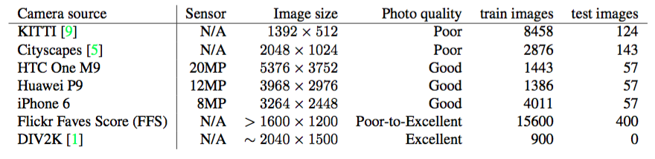
No-reference evaluation in the wild
No aligned image pairs from different cameras are available
Evaluate with no-reference quality metrics
CORNIA: perceptual measure mapping to average human quality assessments for images Signal Processing Measures: Quality of information in an image
Entropy: Pixel level observation
Bits Per Pixel (BPP)
Notes:
WESPE does not require before/after ground truth correspondences to be trained, so in this section we train it on various datasets in the wild whose main characteristics are shown in Table 4 as used in our experiments.
we complement the DPED dataset containing photos from older phones with pictures taken by phones marketed as having state-of-the-art cameras: the iPhone 6, HTC One M9 and Huawei P9.
We additionally consider two widely-used datasets in Computer Vision and learning: the Cityscapes and KITTI public datasets. They contain a large-scale set of urban images of low quality, which forms a good use case for automated quality enhancement. That is, Cityscapes contains photos taken by a dash-camera (it lacks image details, resolution and brightness), while KITTI photos are brighter, but only half the resolution, disallowing sharp details (see Figure 5). Finally, we use the recent DIV2K dataset of high quality images and diverse contents and camera sources as a target for our WESPE training.
Importantly, here we evaluate all images with no-reference quality metrics, that will give an absolute image quality score, not a proximity to a reference. For objective quality measurement, we mainly focus on the Codebook Representation for No-Reference Image Assessment (CORNIA): it is a perceptual measure mapping to average human quality assessments for images. Additionally, we compute typical signal processing measures, namely image entropy (based on pixel level observations) and bits per pixel (bpp) of the PNG lossless image compression. Both image entropy and bpp are indicators of the quantity of information in an image.
We train WESPE to map from one of the datasets mentioned above to the DIV2K image dataset as target. We also report absolute quality measures (i.e., bbp, entropy and CORNIA scores) on original DPED images as well as APE- enhanced, [13]-enhanced and WESPE-enhanced ([DPED] and [DIV2K] variants) images in Table 3, and take the best-performing methods to compare on the remaining datasets in Table 6.

Slide 18
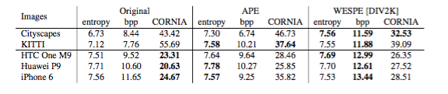
No-reference evaluation in the wild
Stronger improvement for low-quality cameras
Proximity to ground truth is not the only matter of importance
Notes:
Table 3: Average entropy, bit per pixel and CORNIA (lower is better) results on DPED test images. Best results are in bold.
Table 6: Average entropy, bit per pixel and CORNIA scores on five test datasets. Best results are in bold.
Table 3 shows that the DIV2K variant of WESPE generates the best overall image quality, surpassing [13] and the WESPE variant that targets DPED DSLR images. This confirms the impression that proximity to ground truth is not the only matter of importance. This table also shows that improvement is stronger for low-quality cameras (iPhone and Blackberry) than for the better Sony camera, which probably benefits less from the WESPE image healing. Moreover, targeting the DIV2K image quality domain seems to improve over the DPED DSLR domain: WESPE [DIV2K] generally improves or competes with WESPE [DPED] and even the fully supervised [13] network.
On datasets in the wild (Table 6), WESPE and APE improve the original images on all metrics on the urban images (KITTI and Cityscapes). WESPE demonstrates significantly better results on the CORNIA and bpp metrics, but also on image entropy. Recall that KITTI and Cityscapes consist of images of poor quality, and our method is successful in healing such pictures. On the smartphones, whose pictures are already of high quality, our method shows improved bpp and slightly worse CORNIA scores, while keeping image entropy on par. The latter findings are quite ambiguous, since visual results for the urban (Figure 5) and phone datasets (Figure 6) demonstrate that there is a significant image quality difference that is not fully reflected by the entropy, bpp, and CORNIA quantitative numbers as proxy measures for perceived image quality. Moreover, since the correlation between objective scores and human perception can be debatable, in the following subsections we provide a complementary subjective quality evaluation.

Slide 19
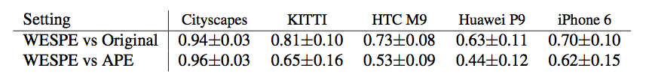
User Study
User study comparing subjective evaluation
Original, APE-enhanced and WESPE-enhanced photos with DIV2K as target
Pairwise forced choice method
WESPE images are preferred on average
Notes:
conducted a user study comparing subjective evaluation of the original, APE-enhanced and WESPE-enhanced photos with DIV2K as target, for the 5 datasets in the wild
To assess subjective quality, we chose a pairwise forced choice method. The user’s task was to choose the preferred picture among two displayed side by side. No additional selection criteria were specified, and users were allowed to zoom in and out at will without time restriction.
users were shown a before vs. after WESPE-enhancement pair and a APE- enhanced vs. WESPE-enhanced pair to compare. 38 people participated in this survey
WESPE-improved images are on average preferred over non-enhanced original images
WESPE results are clearly preferred over the APE ones,
On the modern phone cameras, users found it difficult to distinguish the quality of the WESPE-improved especially when the originals were already of good quality

Slide 20
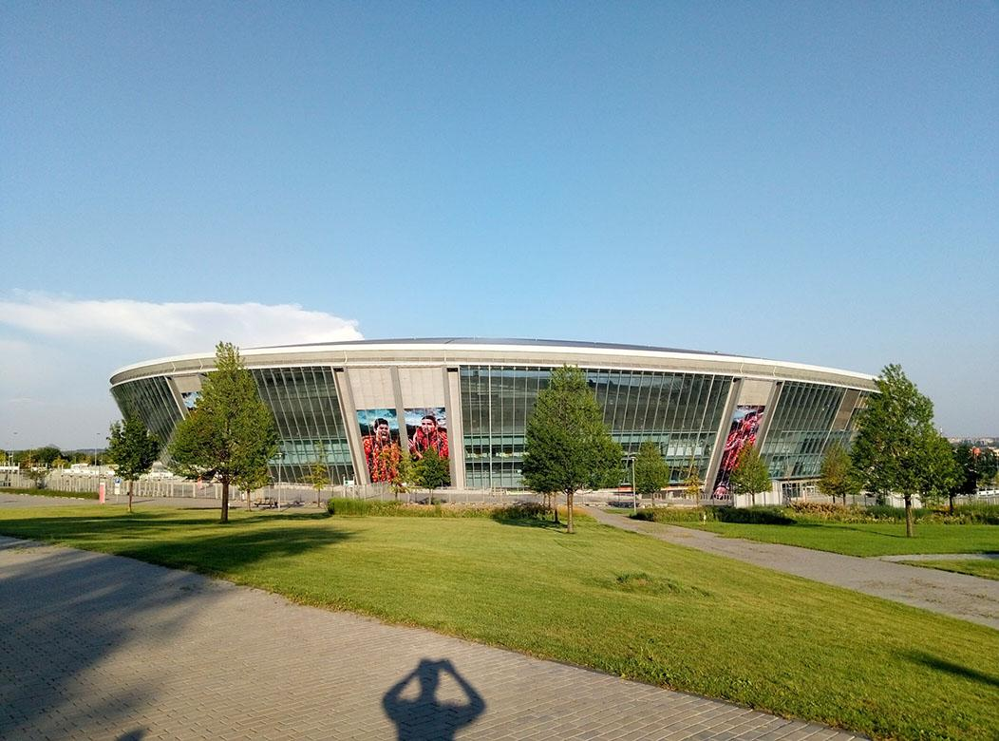
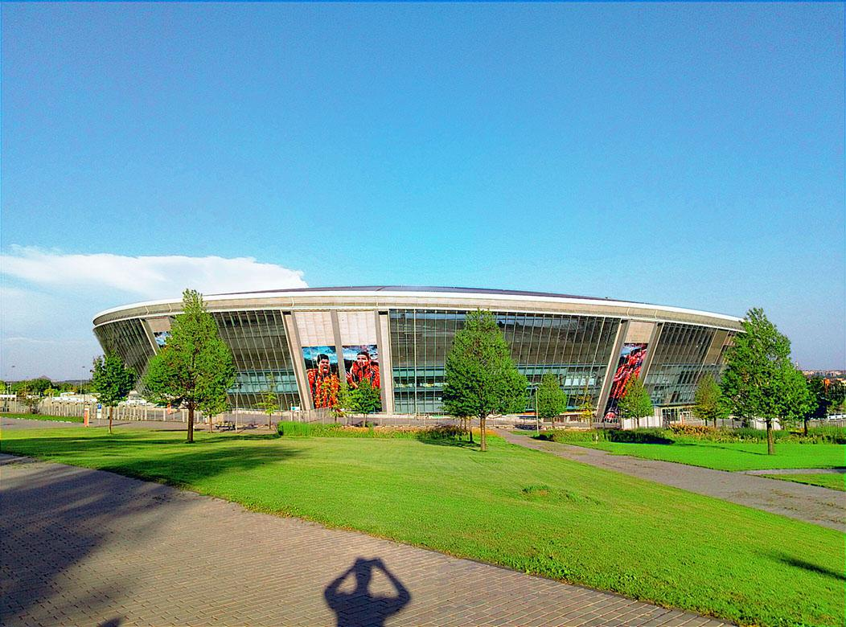

Slide 21
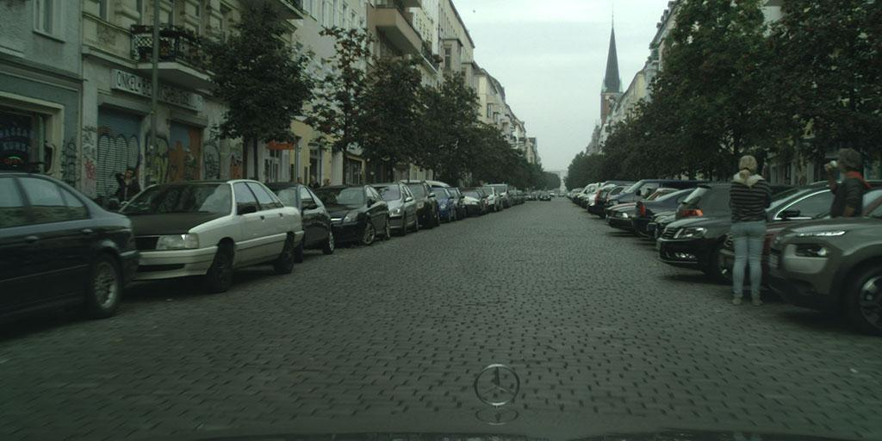
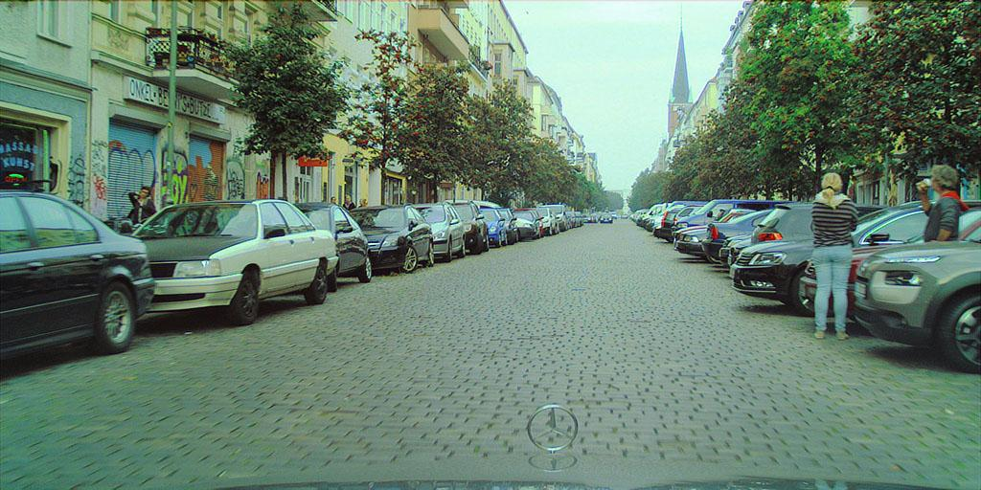
Notes:
CityScapes

Slide 22
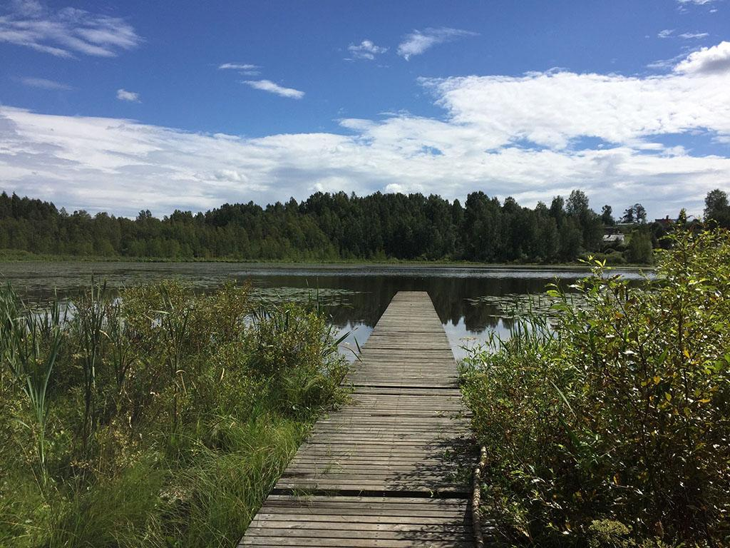
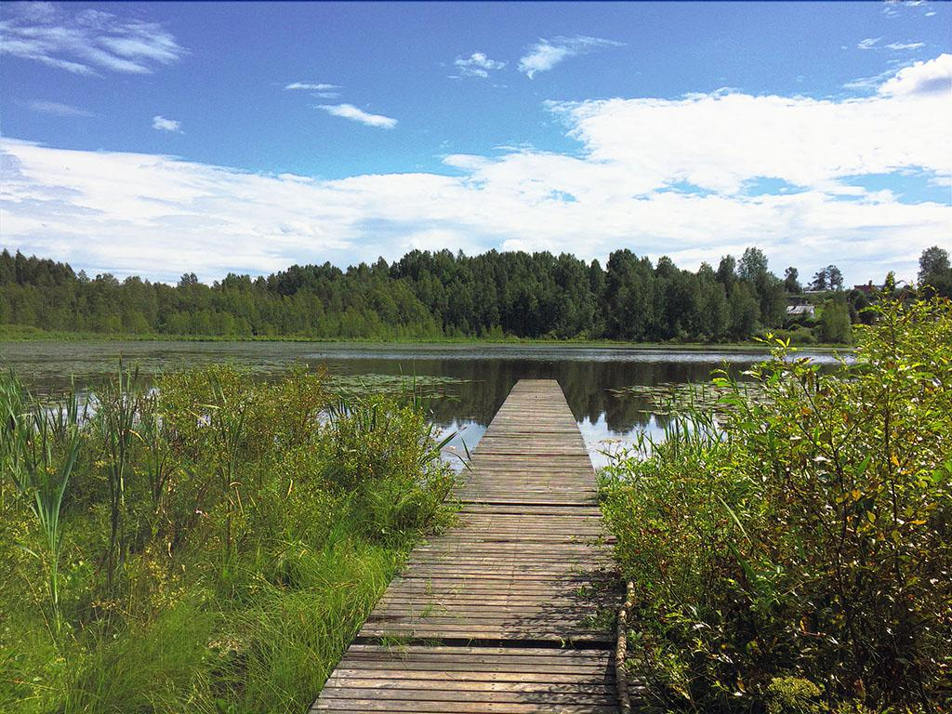
Notes:
Iphone 6

Slide 23

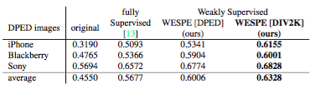
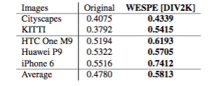
Flickr Faves Score
Virtual Rater to mimic Flickr user behavior
“World’s largest photographer focused community” (Flickr.com)
Trained a binary classifier CNN to predict favourite status of an image by an average user
(FFS(I) = #F (I )/#V (I ))
Trained a VGG19- style CNN to classify image Fave status
Notes:
Gathering human-perceived photo quality scores is a tedious hence non-scalable process. To complement this, we train a virtual rater to mimic Flickr user behavior when adding an image to their favorites. Under the assumption that users tend to add better rather than lower quality images to their Faves, we train a binary classifier CNN to predict favorite status of an image by an average user, which we call the Flickr Faves Score (FFS).
collect a Flickr Faves Score dataset (FFSD) consisting of 16K photos randomly crawled from Flickr along with their number of views and Faves.
FFS = the number of times is was fav’ed over the number of times it was viewed, assume this strongly depends on over- all image quality. We then binary-label all images as either. low –or high-quality based the median FFS: below median is low-quality, above is high-quality.
train a VGG19-style [26] CNN on random 224 × 224px patches to classify image Fave status and achieve 68.75% accuracy on test images. The network was initialized with VGG19 weights pre-trained on ImageNet, and trained until the early stopping criterion is met with a learning rate of 5e-5 and a batch size of 25. We split the data into training, validation and testing subsets of 15.2K, 400 and 400 images, respectively.
Per-dataset average FFS scores are shown in Tables 7 and 8. Note that this labeling differs from pairwise preference selection as in our user study of section 4.3: it’s an absolute rating of images in the wild, as opposed to a limited pairwise comparison.
Our first observation is that the FFS scorer behaves coherently with all observations about DPED: the three smartphones’ original photos that were termed as ‘poor’, ‘mediocre’ and ‘average’ in [13] have according FFS scores (Table 7, first column), and the more modern cameras have FFS scores that are similar to the best DPED smartphone (i.e., Sony) camera (Table 8, first column)
Finally, poorer- quality images in the Cityscapes and KITTI datasets score significantly lower. Having validated our scalable virtual FFS rater, one can note in Tables 7 and 8 that the FFS scores of WESPE consistently indicate improved quality over original images or the ones enhanced by the fully supervised method of [13]. Furthermore, this confirms our (now recurrent) finding that the [DIV2K] variant of WESPE improves over the [DPED] one.

Slide 24
Conclusion
WESPE – a weakly supervised solution for the image quality enhancement problem
Free of strong supervision in the form of aligned source-target training image pairs
Map low-quality photos into the domain of high-quality photos without any correspondence between them
Transitive architecture based on GANs and loss functions designed for accurate image quality assessment
Comparative or superior results to past methods
Notes:
our experiments reveal that WESPE demonstrates the performance comparable or surpassing the traditional enhancers and competes with the current state of the art supervised methods, while relaxing the need of supervision thus avoiding tedious creation of pixel-aligned datasets.

Slide 25
References
A. Ignatov, N. Kobyshev, R. Timofte, K. Vanhoey, and L. Van Gool. WESPE: Weakly Supervised Photo Enhancer for Digital Cameras. arXiv:1709.01118 [Cs]. Retrieved from http://arxiv.org/abs/1709.01118, 2017

Slide 26
Thank you!!

